Slide 1
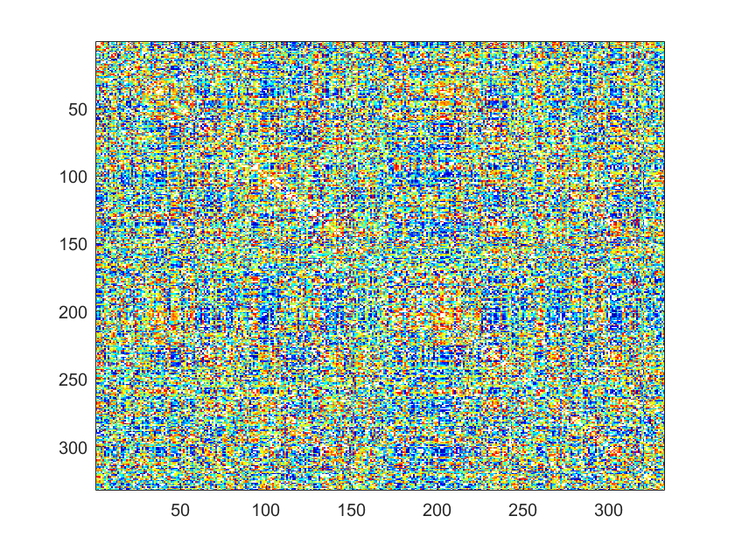
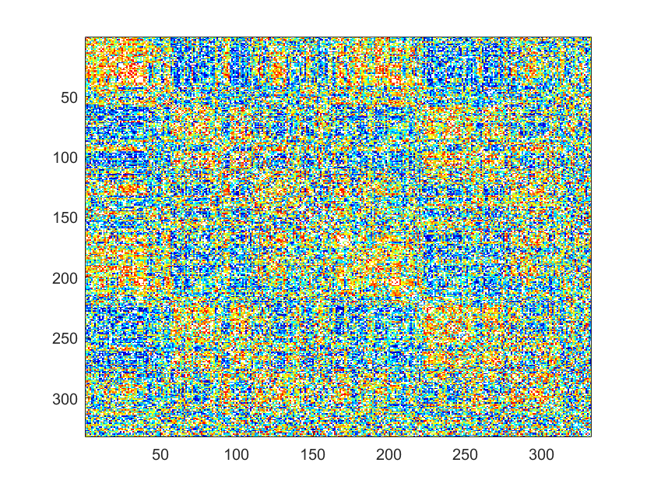
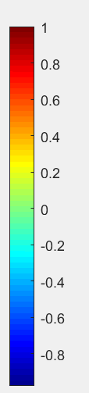
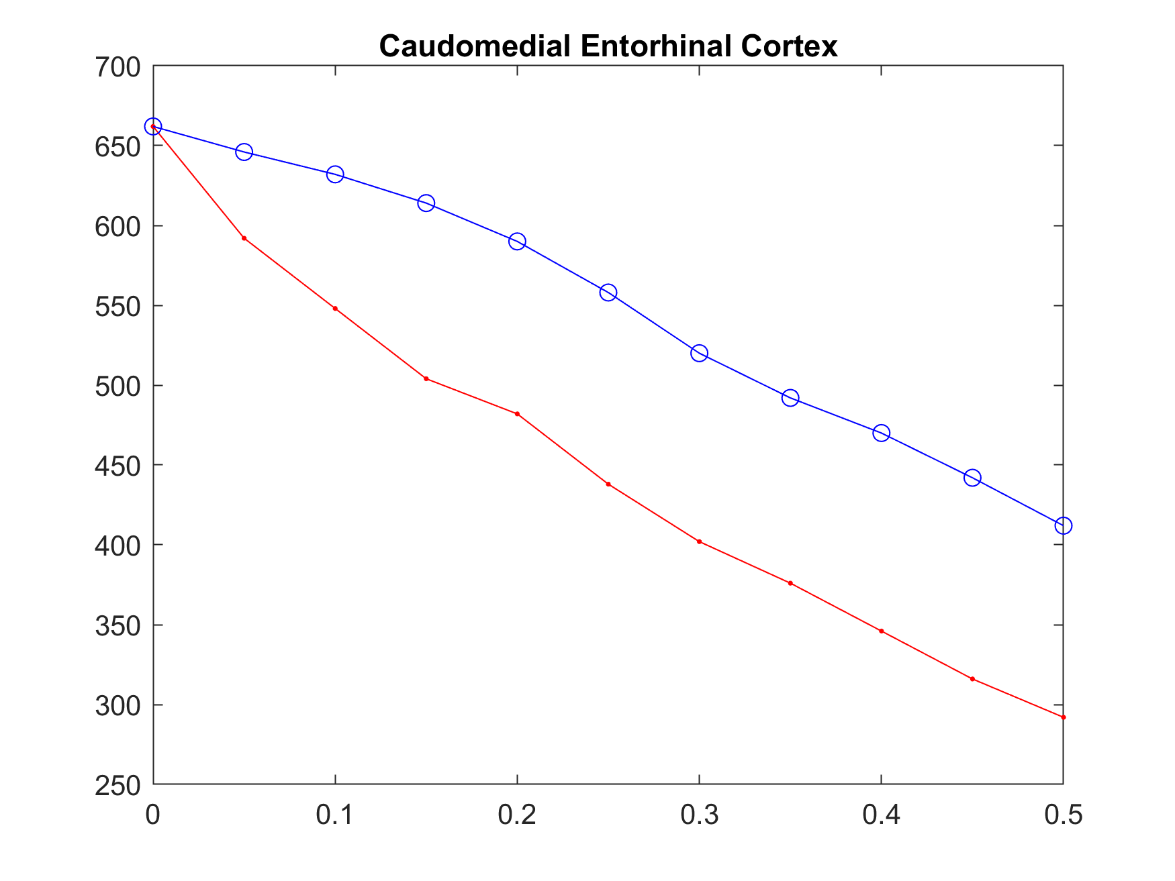
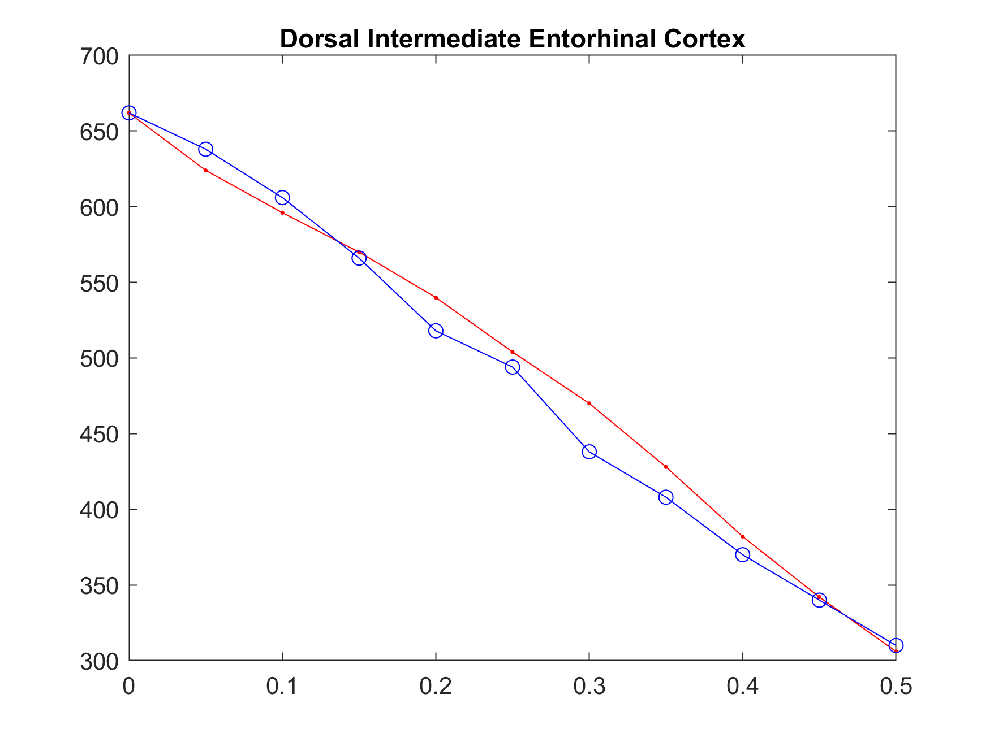
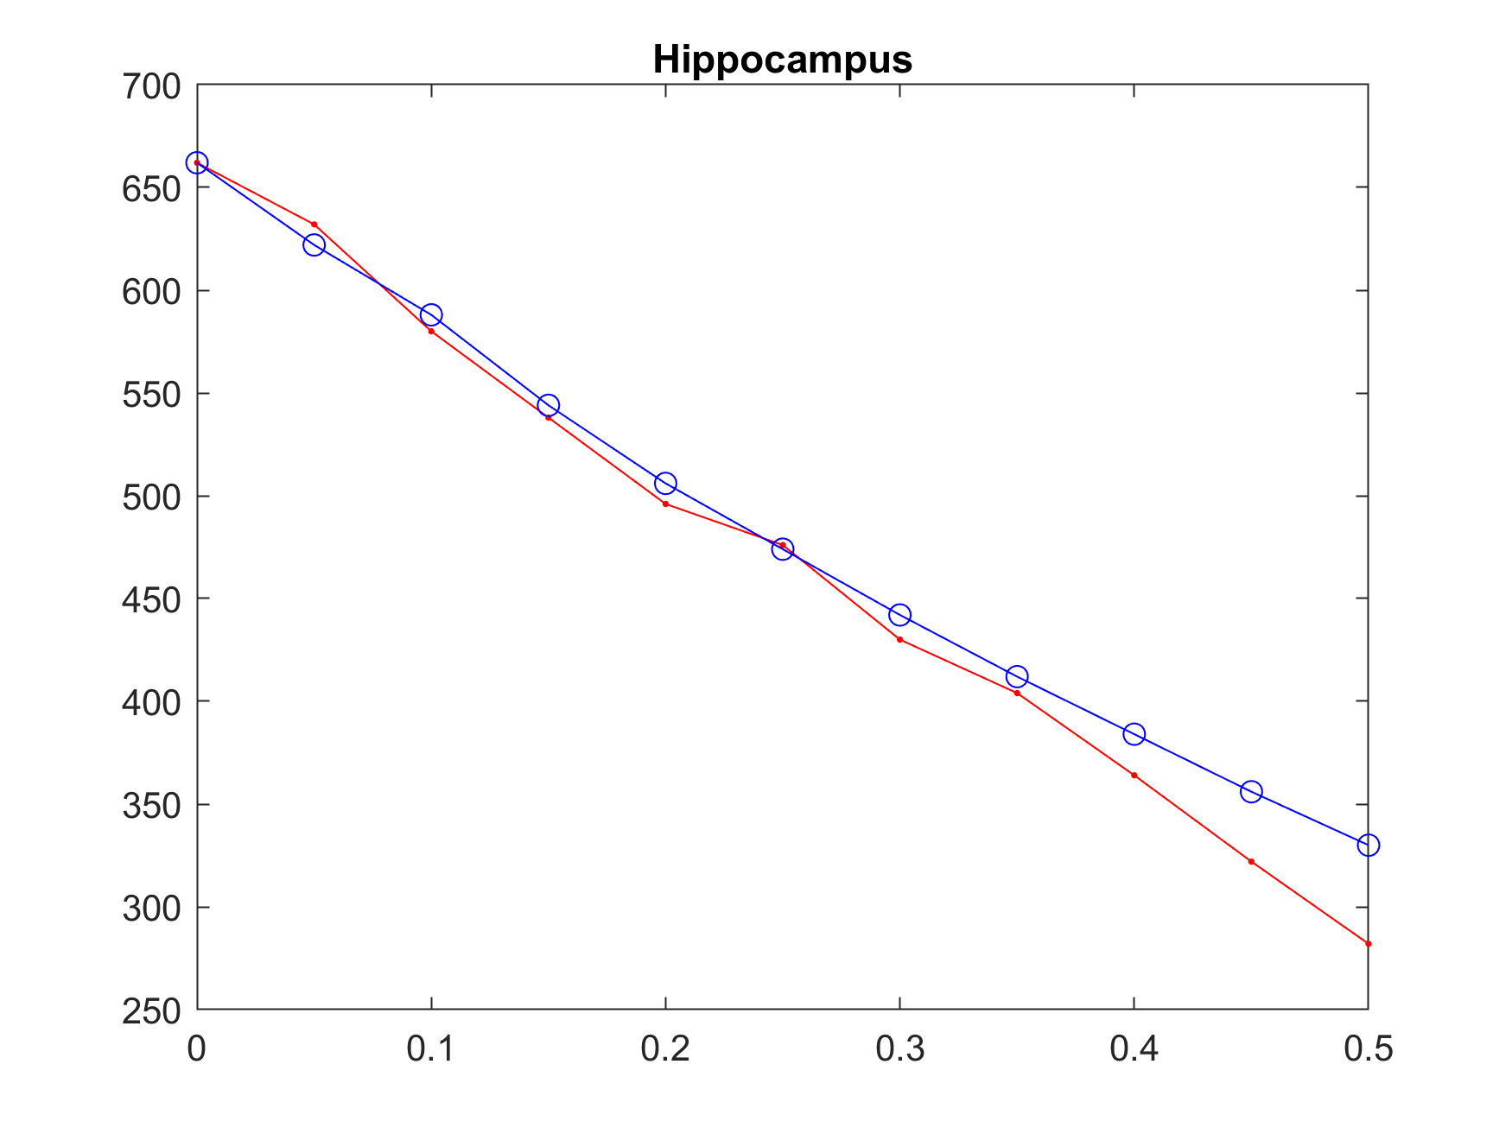
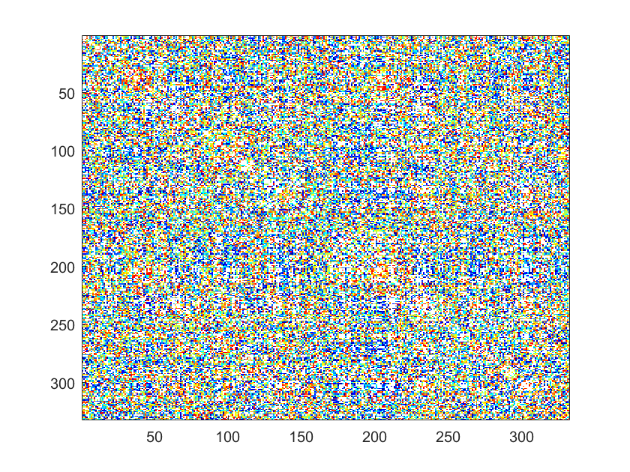
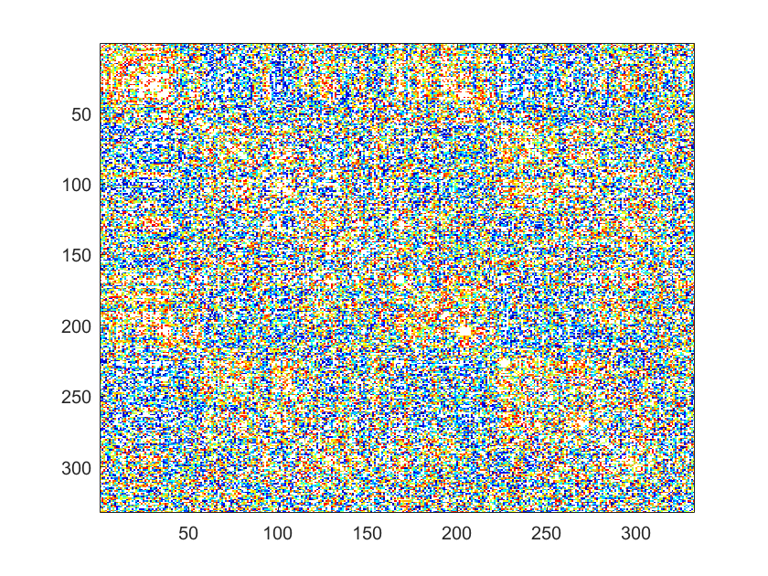
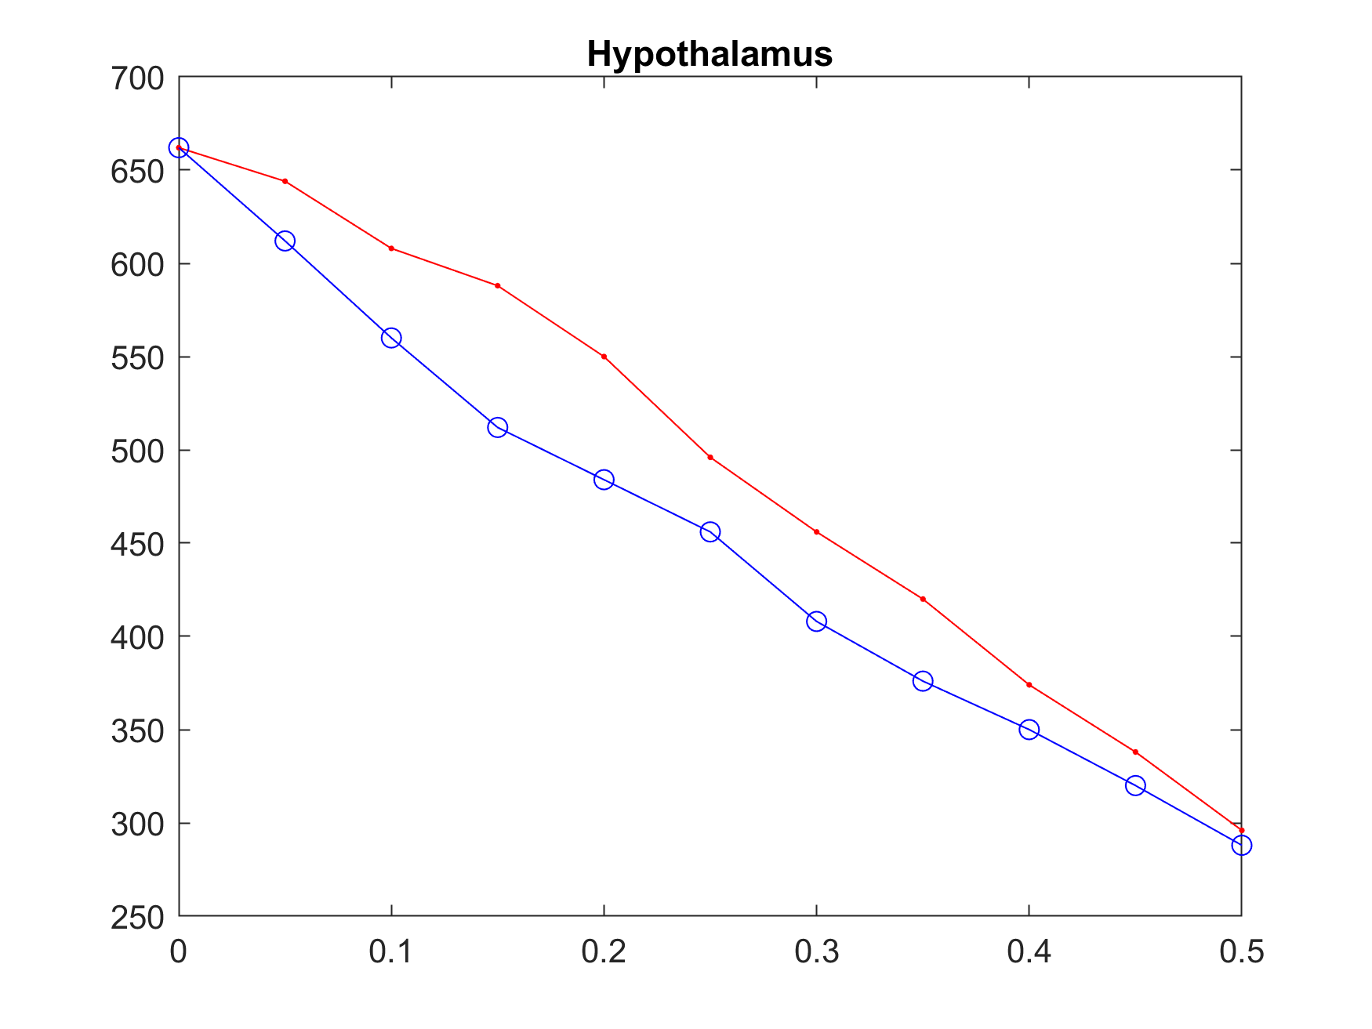
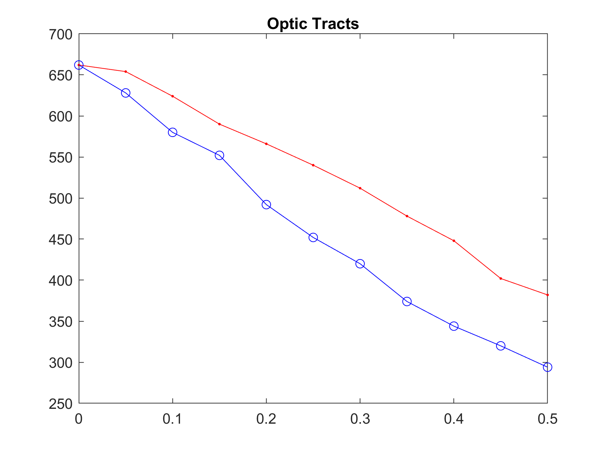
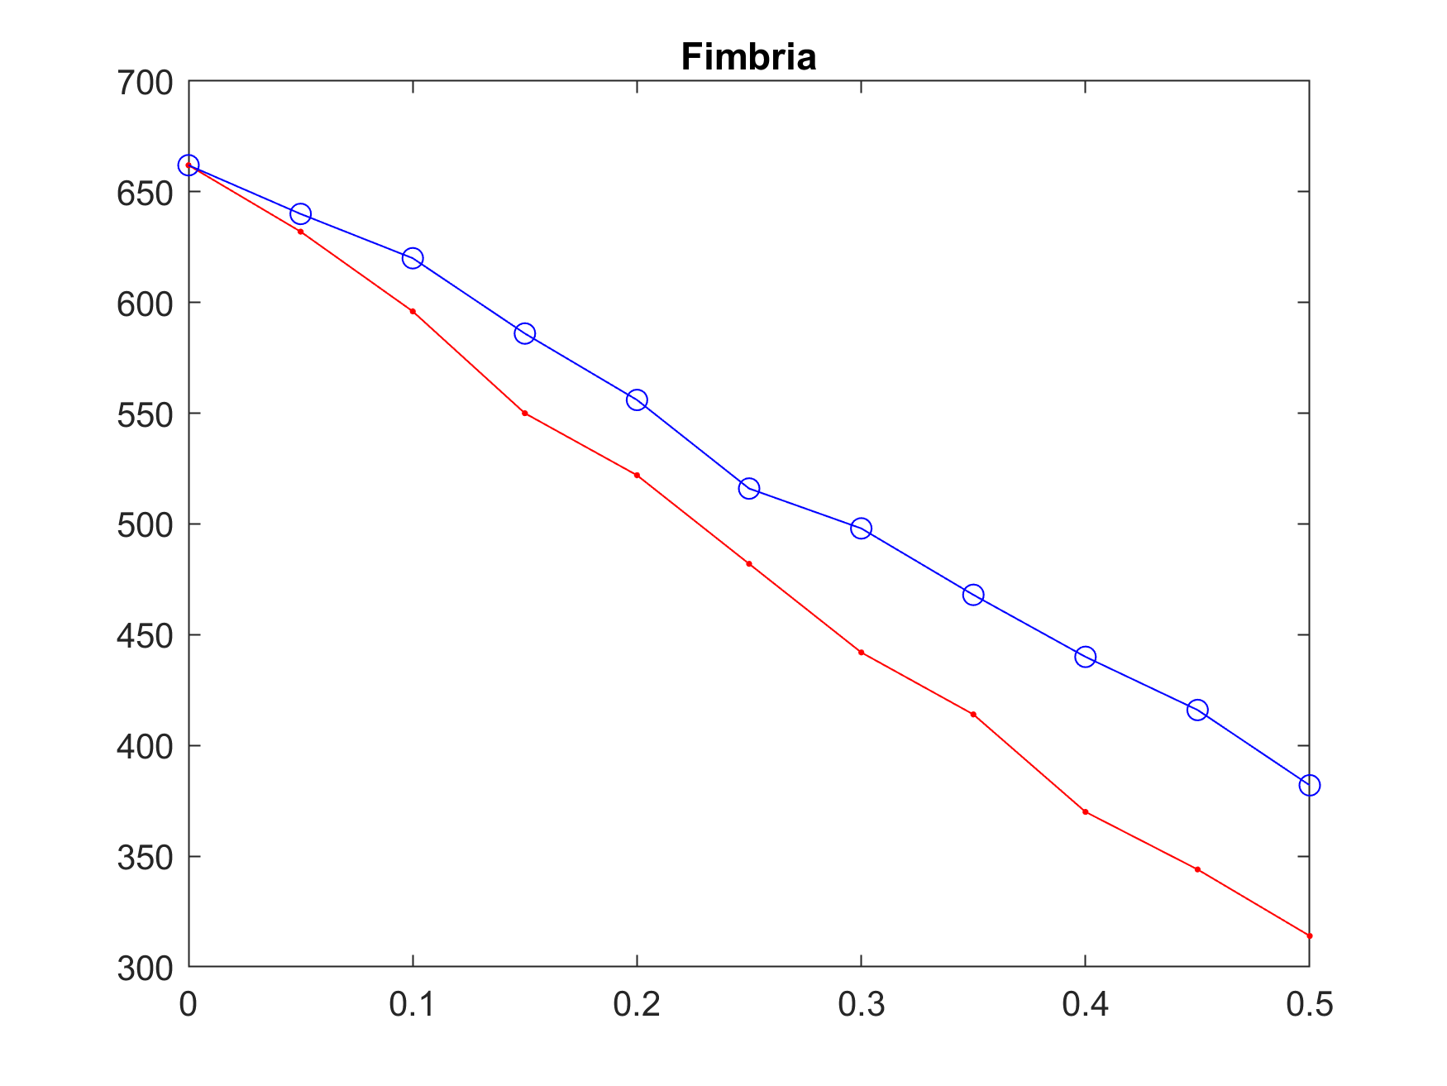
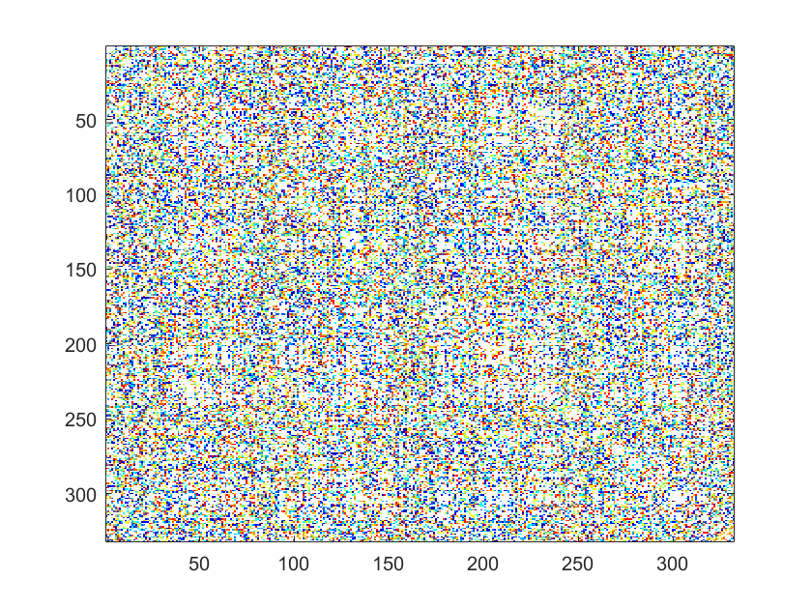
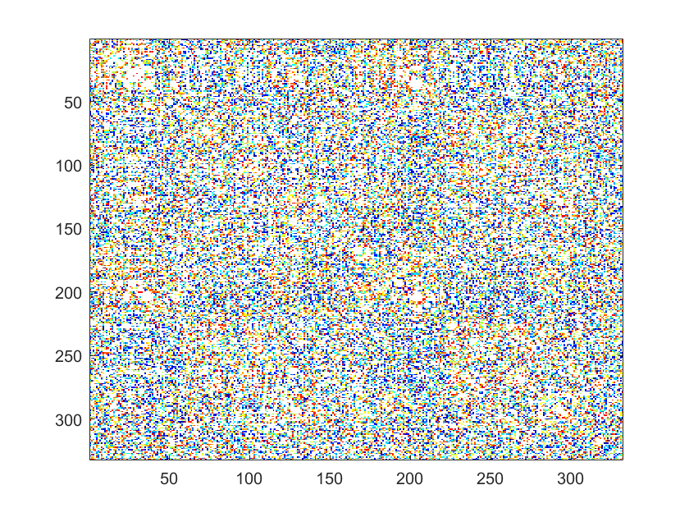
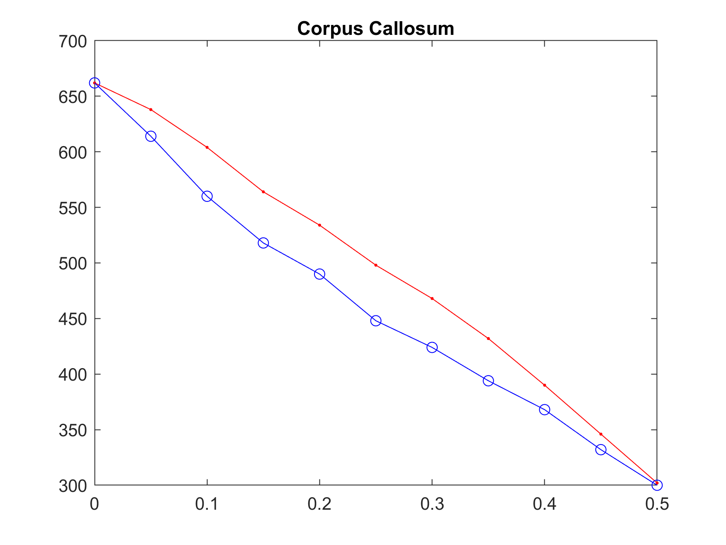
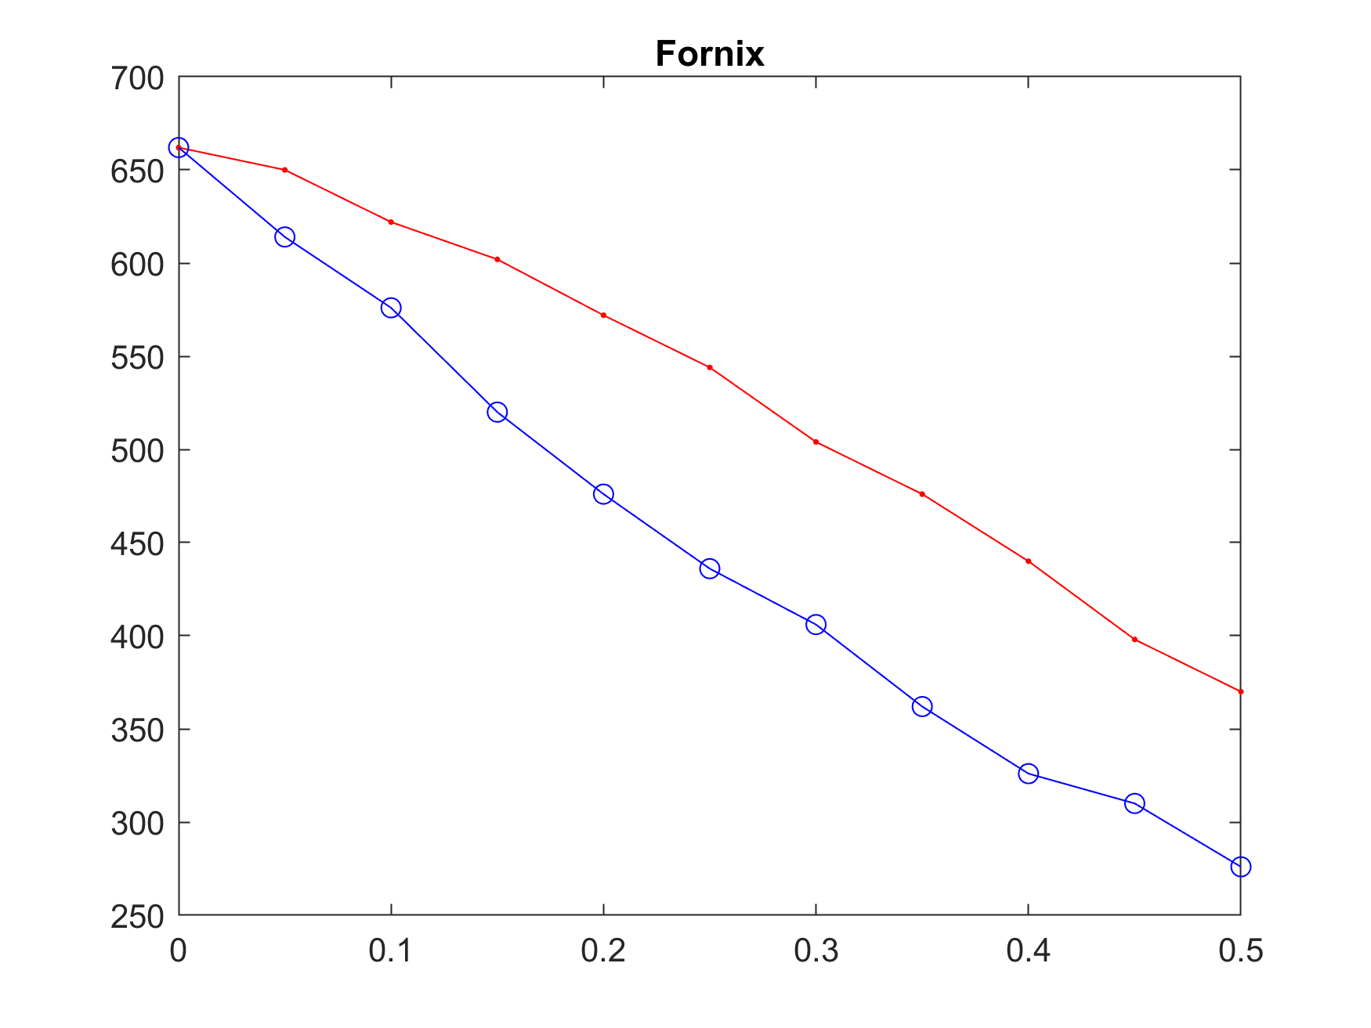
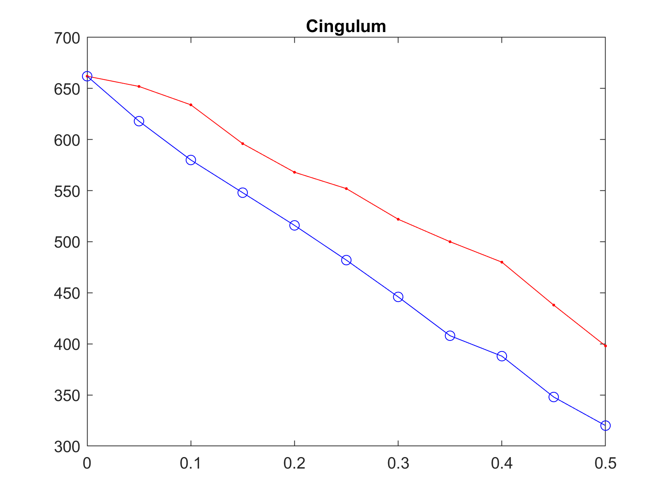
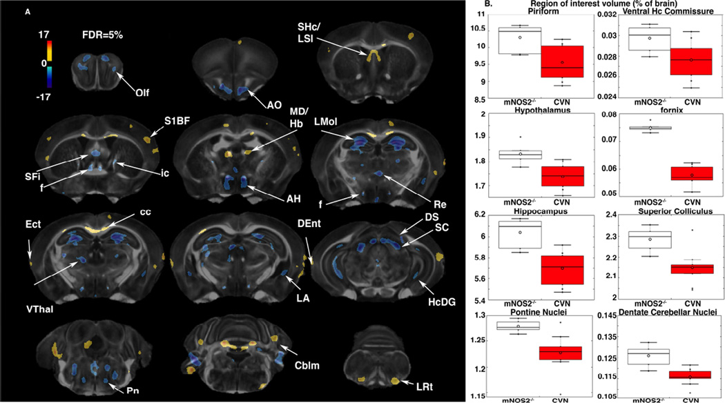
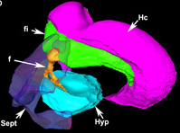
Structural Connectomes as Biomarkers for Alzheimer’s Disease
INTRODUCTION
Badea Alexandra, Wilkinson Natalie
It has been proposed that AD can be viewed from the perspective of connectopathy. Here we examine if such an effect would translate in alterations of the structural volume covariance amongst brain regions using a mouse model of familial AD.
Control:
AD:
Chosen k=0.40
RESULTS
We constructed structural covariance connectomes for each genotype. We have implemented a permutation based testing procedure at various levels of network densities. A quantitative analysis at the global level found no difference between the whole set of regions using structural covariance analysis. [Put Figure of whole brain connectomes for AD in Controls. A quantitative analysis at the regional level found that amongst our 19 regions of interest the preoptic telencephalon showed the larges difference, while the hippocampus difference was in a quantitatively much lower range.
0.05
METHODS
P=0.0129
P=0.000021192
P=0.0530
Homozygous APPSwDI/mNos2 −/− (CVN-AD) mice expressing the Swedish K760N/M671L, Dutch E693Q, and Iowa D694N human APP mutations under control of the Thy-1 promoter (Davis et al., 2004) were compared against age matched mNos2 −/− (B6 129P2Nos2tau1Lau/J) mice (Laubach et al., 1998) (Jackson Laboratory stock number 002609, Bar Harbor ME). All mice were genotyped using standard PCR. Mice were bred through the barrier colonies at Duke University, fed standard mouse chow ad libitum, and housed under 12-hour light/12- hour dark cycles, at 21±3°C.
0.25
P=0.0467
P=0.00015272
P=0.000012919
0.50
P=0.00080548
P=0.0110
P=0.0615
Fixed brain specimens were scanned on a 9.4 T, 8.9 cm vertical bore Oxford magnet, with shielded coils, providing gradients up to 2000 mT/m (Resonance Research, Inc. Billerica, MA), and controlled by an Agilent Direct Drive Console (Agilent Technologies, Santa Clara, CA). The DTI protocol used 12 diffusion directions, and TE 12 ms, TR 100 ms, b ≈ 1595 s/mm2 , diffusion pulse width 4.04 ms, separation 5 ms, amplitude 90.94 G/cm). Images were acquired over a 22×11x9.02 mm field of view, with a matrix 400×200x164, and reconstructed at 55 µm isotropic resolution. Specimens were scanned within the cranium to avoid tissue damage and distortions. The scan duration was ~12 hours. (1)
We segmented the brains using an automated pipeline (2) to provide 332 regional volumes, and we selected 19 regions of interest in Alzheimer’s disease. Among these 19 regions of interest are: Caudomedial Entorhinal Cortex, Dorsal Intermediate Entorhinal Cortex, Hippocampus, Hypothalamus, Septum, Amygdala, Superior Colliculus, Cerebellum, Dentate Cerebellum, Optic Tracts, Fimbria, Corpus Callosum, Fornix, and Cingulum. We computed Pearson correlations among each pair of regions, to construct structural covariance connectomes. We compared structural covariance connectomes after binarizing those at a range of networks densities between 5-50% of connections, using 1000 permutations.
DISCUSSION
Future studies will incorporate more network properties, such as the clustering coefficient, and network efficiency, and more animals.
We started by looking at degrees- we will add clustering coefficient and other network frequencies from the BCT Toolbox
CONCLUSION
Insert conclusion here
Guided by this figure in determinations of the specific regions to analyze for connectivity.
REFERENCES
1. Badea A, Kane L, Anderson RJ, Qi Y, Foster M, Cofer GP, et al. The fornix provides multiple biomarkers to characterize circuit disruption in a mouse model of Alzheimer's disease. Neuroimage. 2016;142:498-511.
2. Anderson RJ, Cook JJ, Delpratt NA, Nouls JC, Gu B, McNamara JO, et al. Small Animal Multivariate Brain Analysis (SAMBA): A High Throughput Pipeline with a Validation Framework. eprint arXiv:170910483. 2017:arXiv:1709.10483.
These are the regions specifically examined in the report.

